Slide 1
Week 3
(UMED8H-30-1)
Central Banks

Slide 2
Structure
At the end of this session, you should be able to:
Define the various functions of a central banks.
Understand the origins and structure of the Bank of England, Federal Reserve System and ECB.
Understand the importance of central bank ownership structure and independence.
Reading for this lecture:
Mishkin, F.S., 2018. Financial Market and Institutions, Global Edition, Chapter 9, Central Banking and the Conduct of Monetary Policy. (available online at UWE library)
Readings: Howells and Bain 5th ed, chapter 3

Slide 3
Origins of Central Banks
The History of Banking and The First Central Bank

Slide 4
Origins of Central Banks
The Sveriges Riksbank or the Bank of Sweden (established in 1668) with its main function being lending money to the government of Sweden.
More central banks emerged across Europe as a result of rising global trade that increased the volume of international payments in the seventeenth century.
The Bank of England (BoE) was establishment in 1694.
The central banking functions evolved in order to safeguard monetary stability.
The central banks are required to answer to their parliaments.
The Federal Reserve System (established in 1913) was designed to distribute power over 12 regional Federal Reserve banks and remained privately owned by its member banks.
Most emerging market economies established their central banks after WWII.
The functions of central banks throughout the world expanded to regulating the value of the national currency, financing the government, and acting as a ‘lender of last resort’ to banks suffering from liquidity and/or credit crises.

Slide 5

I-History of Bank of England

Slide 6
History of Bank of England
The Bank of England was founded in 1694 to act as the UK government’s banker and debt manager.
As the second-oldest central bank in the world, the BoE model has been the basis of most other central banks of the world.
Prior to 1946 – BoE was privately owned but the activities were determined by the Government and legislation.
BoE was nationalised in 1946 - wholly-owned by the UK government.
The BoE is accountable to the U.K. Parliament.
The capital of the Bank is held by the Treasury Solicitor on behalf of HM Treasury.
The Government has the power to appoint the Bank’s governors and directors, and to issue directions to the Bank.
On the 6th of May 1997 BoE was given the independence through the BoE Act. Hence, the Bank was granted operational independence = the right to decide the interest rate. However, the Bank is required to meet the Government's stated inflation target.
It makes decisions about the setting of interest rates and the scale of its asset purchase programme without direct political interference.

Slide 7
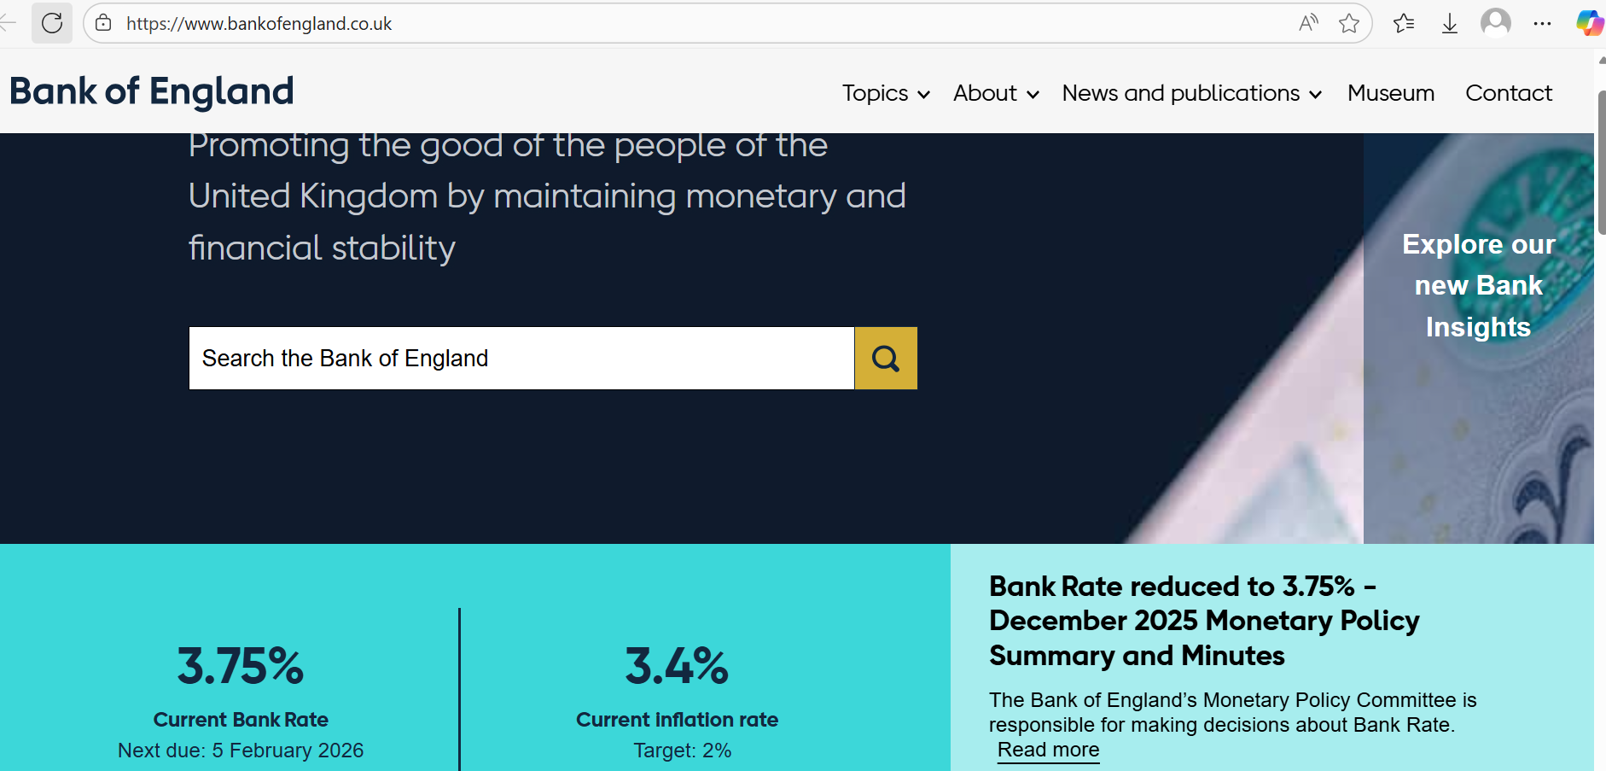

Slide 8
The Functions of Bank of England
1) Implement monetary policy: sets interest rates and manages the supply of money in the economy to achieve its inflation target and support economic growth.
2) Maintain financial stability: promote and act to ensure a stable and resilient financial system (including acting as the lender of the last resort)
3) Issue banknotes: has the exclusive right to issue banknotes in England and Wales and is responsible for ensuring that there is enough money in circulation to meet the needs of the economy.
4) Regulate and supervise financial sector: regulate and supervise banks, building societies, and other financial institutions to ensure that they are operating in a safe and sound manner.
5) Supports the government: provides a wide range of services to the government, including managing its debt and providing financial advice.
6) Banker to the commercial banks – facilitate banks in making payments to each other.
7) Manage the foreign exchange reserves – protect and conserve the gold and foreign exchange reserves.
Notes:
Monetary policy
Financial stability
Banker to banks
Issuing currency

Slide 9
The Court of Directors
BoE is governed by the Court of Directors (like the Board of Governors in US) consists of the governor, two deputy governors, and 16 nonexecutive directors.
The Governor and 2 deputy governors each appointed for 5 years.
Committee of Non-Executive Directors within Court:16 non-executive directors each appointed for 3 years
The Court of Directors is responsible for the overall management of the Bank’s affairs other than the conduct of monetary policy.
The Court sets the Bank’s overall objectives and strategy and seeks to ensure that the Bank’s various functions are carried out effectively.

Slide 10
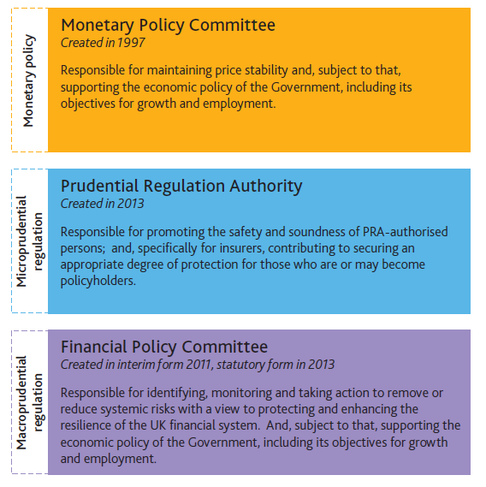
Major decision-making bodies of the Bank of England

Slide 11
The Monetary Policy Committee
The Monetary Policy committee compares with the U.S. FOMC, consisting of the governor, two deputy governors, two other central bank officials (non-executive directors) and four outside economic experts (appointed by the government).
The MPC is responsible for conducting monetary policy so as to meet an inflation target set for it each year by the government.
The MPC’s main tool against inflation is the rate of interest charged by the Bank to its borrowers, the commercial banks.
The MPC meets each month, usually the first Thursday, to set the interest rate.
If the MPC consistently fails to meet the inflation target, the Governor of the Bank of England must write a letter to the Chancellor of the Exchequer explaining what is going on.
When setting interest rates, the MPC must have regard to the government’s wider macroeconomic objectives such as employment and growth.

Slide 12
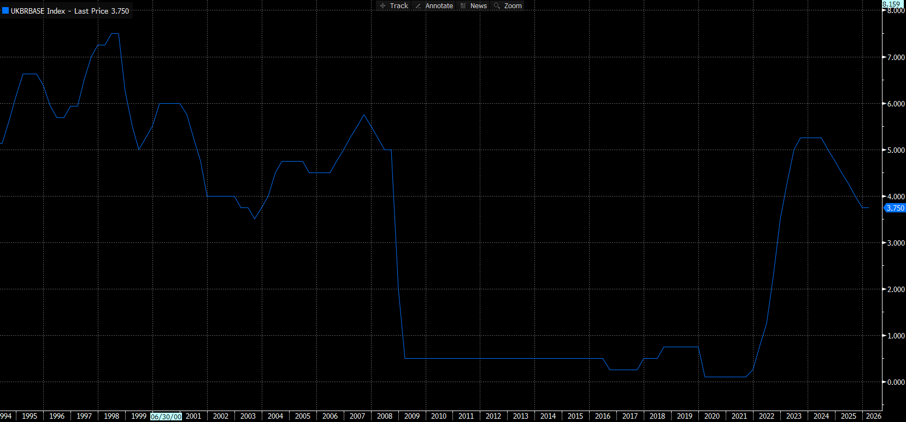
Bank of England Bank Rate
Source: Bloomberg

Slide 13


Slide 14
The Financial Policy Committee
The Financial Policy Committee (FPC) was established in 2013 as part of the new system of regulation brought in to improve financial stability after the financial crisis.
The FPC normally has thirteen members.
Six members are Bank of England staff (the Governor, four Deputy Governors and the Executive Director for Financial Stability Strategy and Risk); five external members (selected based on their experience and expertise in financial services); the Chief Executive of the Financial Conduct Authority and one non-voting member from HM Treasury.
It’s objectives are:
to identify and monitors risks that threaten the resilience of the UK financial system as a whole.
to support the economic policy of the Government.
‘Stress testing is used by the Bank to make sure the financial system, including banks and building societies, insurance companies and central counterparties, is strong enough to withstand severe scenarios such as a financial crisis’.
For example, scenario used for the 2021 solvency stress test was not a forecast. It is a severe path for the economy in 2021–25 on top of the economic shock associated with the Covid pandemic that occurred in 2020. UK residential property prices fall by 33% in the stress scenario and UK unemployment rises by 5.6 percentage points to peak at 11.9%.

Slide 15
The Prudential Regulation Committee
The PRC is responsible for the regulation and supervision of banks, building societies, credit unions, insurers, and major investment firms.
It ensures the stability and resilience of the financial system.
Members : the Governor of the Bank of England; Deputy Governors for Financial Stability, Markets and Banking, and Prudential Regulation; the Chief Executive of the Financial Conduct Authority; a member appointed by the Governor with the approval of the Chancellor; and six other external members appointed by the Chancellor.

Slide 16
II-History of Federal Reserve System
The First Bank of the United States was a national bank chartered by the United States Congress in 1791.
It was the first attempt at central banking in the country and was created to address various financial challenges facing the newly formed United States.
Fear of centralised power and distrust of moneyed interests led to its dissolution in 1811.
The Second Bank was established in 1816 to address the financial challenges facing the nation after the War of 1812 and to stabilise the currency.
It was dissolved in 1836 due to fear that the bank concentrated too much power in the hands of a few and was detrimental to the interests of ordinary citizens.
Without a lender of last resort, banking panics became regular events in 1907.
Widespread bank failures and depositor losses convinced the U.S. that a central bank was needed.
Questions arose as to whether such a monetary authority would be private or a government institution.
The Federal Reserve System was created under the Federal Reserve Act of 1913.

Slide 17
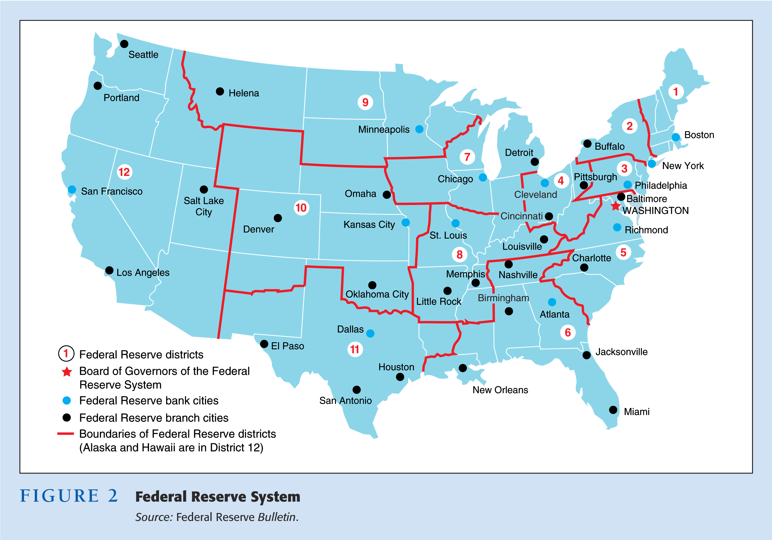
Source: Mishkin, The Economics of Money, Banking and Financial Markets, Addison Wesley.

Slide 18
Structure of Federal Reserve System
The Federal Reserve Banks are quasi-public institutions since they are owned by the private commercial banks in the district where the Reserve Bank is located.
Design was intended to diffuse power along the following dimensions:
─ Regions of the U.S.
─ Government and private sector interests
─ Needs of bankers, businesses, and the public
The Federal Reserve System as it exists now includes:
─ Twelve Federal Reserve Banks
─ Board of Governors (BOG) of the Federal Reserve System
─ Federal Open Market Committee (FOMC)
─ Federal Advisory Council
─ Member Banks (around 2,800)
The members of the Board of Governors are appointed by the president of the United States and confirmed by the Senate.
The FOMC makes decisions regarding the conduct of open market operations.

Slide 19
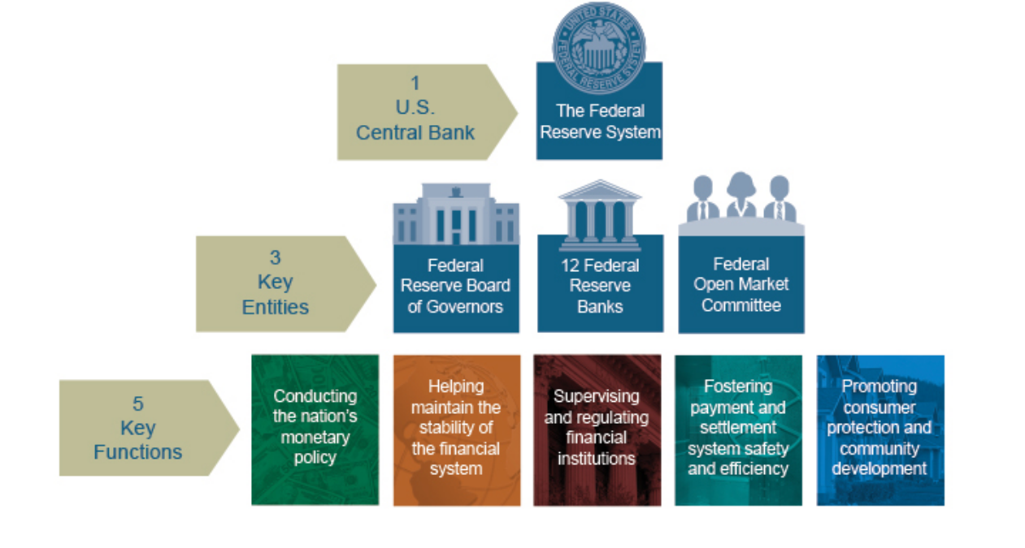

Slide 20
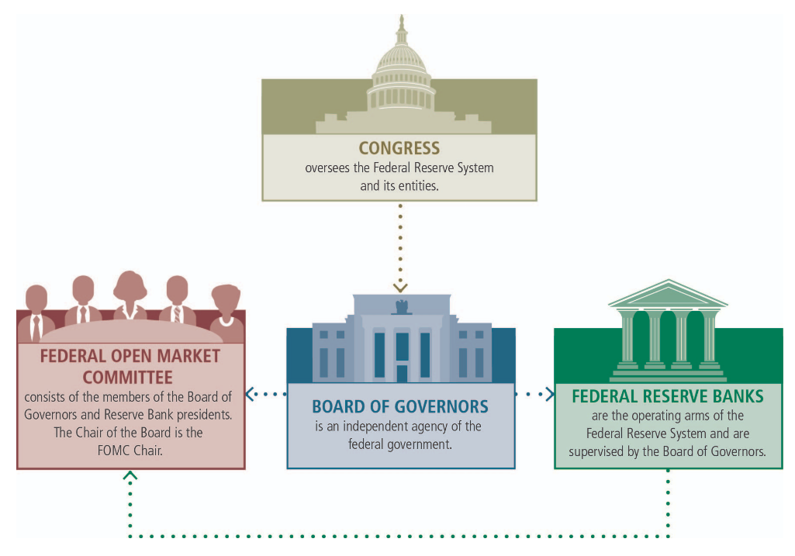

Slide 21
III-The European Central Bank
Founded (as it currently exists) in 1999 by a treaty between the European Central Bank (ECB) and the European System of Central Banks (ESCB).
It is the central bank for the 19 European Union (EU) countries that have adopted the euro as their currency.
The ECB is housed in Frankfurt, Germany.
The three main decision-making bodies of the European Central Bank are:
The Governing Council - consists of governors from the 19 Euro area NCBs and members of the Executive Board
The Executive Board - consists of the president and the vice-president of the ECB along with 4 other members
The General Council - consists of the president and the vice-president of the ECB and the governors of the NCBs of the 28 EU member states.
The ESCB includes the ECB and the national central banks (NCB) of all the EU member states, including those that have not adopted the Euro.

Slide 22
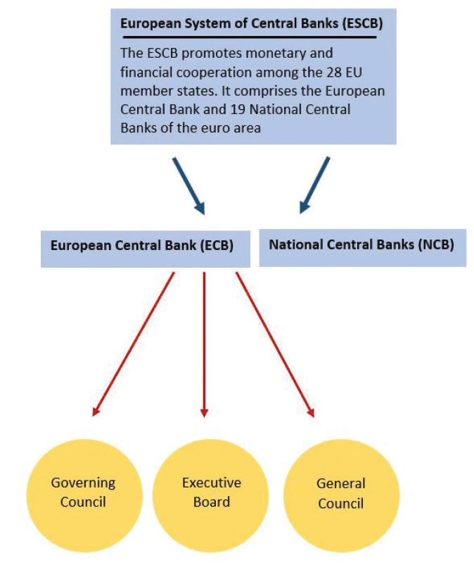
ESCB Structure

Slide 23
Structure of ECB
Governing Council: This is the main decision-making body of the ECB, and is responsible for setting monetary policy, approving the budget, and making key decisions about the operation of the bank. The Governing Council is composed of the President of the ECB, the Vice President, and the heads of the national central banks of the 19 eurozone countries.
Executive Board: The Executive Board is responsible for the day-to-day management of the ECB and implements the decisions of the Governing Council. The Executive Board is composed of six members, including the President and Vice President of the ECB.
General Council: The General Council provides advice to the Governing Council on matters related to the implementation of monetary policy and the functioning of the eurozone economy.
Supervisory Board: The Supervisory Board is responsible for the supervision of eurozone banks. It oversees the work of the Single Supervisory Mechanism, which is the eurozone's system for supervising banks.
National Central Banks: The national central banks of the 19 eurozone countries play an important role in the operations of the ECB, as they are responsible for implementing the ECB's monetary policy in their own countries and for providing support to the ECB in carrying out its operations.

Slide 24
Functions of ECB
1) Conducting monetary policy - adjusting the money supply and interest rates to influence economic growth and maintain price stability.
2) Maintaining price stability: setting interest rates, managing the money supply, and implementing other monetary policies.
3) Supervising the banking system: ensuring the stability of the Eurozone financial system and protecting consumers.
4) Providing liquidity to the financial system: helps to maintain stability in the eurozone during times of economic stress.
5) Promoting sustainable economic growth: setting monetary policy and maintaining price stability.
6) Managing the Euro (currency used by the 19 eurozone countries) – by issuing euro banknotes and coins, managing the eurozone's foreign exchange reserves, and promoting the use of the euro around the world.
7) Promoting economic and monetary union: supporting the harmonization of economic policies and the integration of financial markets.

Slide 25
IV- Ownership of Central Banks
Arguments for public ownership:
Central banks act in the ultimate public interest.
Private ownership bias central banks toward self-serving profit-making interests, hence increasing risk-taking and balance sheet troubles.
The global financial crisis highlighted concerns that the profit-making target of private shareholders could hamper them from saving the financial sector during financial crises.
Arguments for private ownership:
guarantees central bank independence (concerned with financing the fiscal deficit)
private owners are required to recapitalise the central bank in the case of losses which lifts this burden off the fiscal budget.

Slide 26
v-Central Bank Independence
THE IDEA that central banks should enjoy some independence is as old as central banking. “I want [it] to be sufficiently in the hands of the government, but not too much,” mused Napoleon Bonaparte in 1806 of the recently created Bank of France
https://www.bis.org/review/r230112b.pdf
http://www.youtube.com/watch?v=aSHqz5tEUl0

Slide 27
Type of Central Bank Independence
Instrument Independence: the ability of the central bank to choose and implement the monetary policy tools or instruments necessary to achieve its goals (“how to”). These instruments may include setting interest rates, conducting open market operations, and employing other tools to control the money supply.
Goal Independence: the ability of the central bank to determine its primary policy objectives or goals (“what to”). These objectives often include maintaining price stability, controlling inflation, and promoting overall economic stability.

Slide 28
Measures of Central Bank Independence
Goal or instrument independence
The degree of government involvement in appointing the Bank’s senior officers
The extent of government representation on the Bank’s board
The length of term of senior officers compared with government
The terms of the Bank’s charter

Slide 29
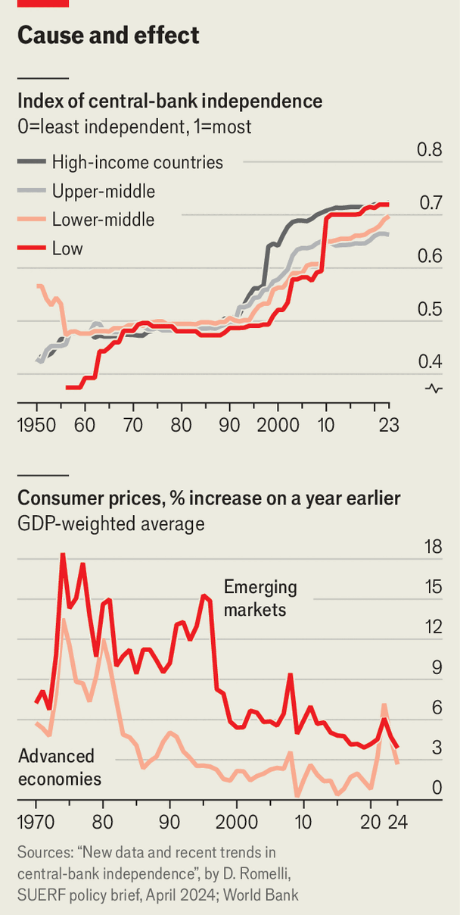
Central Bank Independence Index

Slide 30
Central Banks Independence
The theoretical explanation for the correlation between low inflation and central bank independence is that democratically elected governments have an electoral incentive to raise inflation prior to an election in order to win favour with the electorate.
Governments will instruct their central banks to reduce interest rates so as to inflate the money supply and fuel an economic boom. (in the short-run, high money growth does lead to lower interest rates but in the long-run can lead to higher inflation).
The result may be that the government succeeds in winning the election, but at the cost of increased inflation.
Because it does not have to appeal to the electorate, an independent central bank has no incentive to raise inflation.
An independent central bank can take countervailing action when it suspects that the government is acting in ways that jeopardize price stability.
It will have an incentive to keep inflation low either because it is charged to do so by its charter, or because it must meet an inflation target set by the government.

Slide 31
Central Banks Independence
Critics of central bank independence argue that the link between low inflation and central bank independence may be less clear than the empirical evidence suggests.
Critics point to the postwar inflation of Germany.
It is true that Germany had an independent central bank and enjoyed decades of very low inflation.
There was, however, a social/cultural bias towards low inflation in Germany where, in the 1920s and again in the late 1940s, inflation wiped out the savings of millions of German savers and reduced transactions to barter.
Since then, German consumers, employers and trade unions have been strongly opposed to economic policies that might trigger a rise in inflation.
Critics of central bank independence say that ‘the then German central bank (the Bundesbank) would have found it easy to keep inflation low whether or not it had been independent’.
Notes:
Central bank decisions — as they happened: Powell says no rush to adjust Fed policy stance; Canada cuts rates for sixth consecutive meeting

Slide 32
Case For Independence
The notion of the political business cycle stems from the previous argument.
Expansionary monetary policy leads to lower unemployment and lower interest rates—a good idea just before elections.
Post-election, this policy leads to higher inflation, and therefore, higher interest rates—effects that hopefully disappear (or are forgotten) by the next election.

Slide 33
Case For Independence
Other arguments include:
─ The Treasury may seek to finance the government through bonds purchased by the central bank. This may lead to an inflationary bias.
─ Politicians have repeatedly shown an inability to make hard choices for the good of the economy that may adversely affect their own well-being.
─ Its independence allows the CBs to pursue policies that are politically unpopular, yet in the best interest of the public.

Slide 34
Case Against Independence
Fed independence can be viewed by some as “undemocratic”—an elite group controlling an important aspect of the economy but accountable in few ways.
The parliament is accountable for the state of the economy, yet they have little control over one of the most important tools to direct the economy.
CBs have made mistakes in the past during the Great Depression and inflationary periods.
CB can succumb to political pressure regardless of any state of independence. This pressure may be worse with few checks and balances in place.
Empirical work suggests that countries with the most independent central banks do the best job of controlling inflation.
Evidence also shows that this is achieved without negative impacts on the real economy.

Slide 35
New Challenges for Central Bank Independence
Over much of the past decades, as inflation was low, central bank independence has hardly been at the centre of public policy debates.
With inflation rates running up to 10% in the euro area, the core mandate of central banks – price stability – is a key policy issue today.
According to a Eurobarometer poll conducted in the fall of 2022, 42% of respondents in Europe mention rising prices and (high) costs of living as the most important issues facing the EU, followed by energy supply (29%) and the international situation (20%).
Changes in the macroeconomic situation has implications for the perception of central banks.
High levels of debt can lead to conflicts between price and financial stability.

Slide 36
Summary
From a historical context,
First Central Bank: Sveriges Riksbank (Sweden, 1668)
Bank of England (1694): First modern Central Bank
The Federal Reserve (USA, 1913): Created in response to banking crises
Functions and roles of central banks
Central banks become more independent –strengths and weaknesses.

